Slide 1
Work-Study
OFF-Campus
Jobx Training
21-22
Notes:
This presentation is for OFF-Campus Community Supervisors on how to use Jobx to post and manage work-study positions. If you are an ON campus UNC supervisor, please visit the ON campus UNC supervisor OSSA website here for your trainings:

Slide 2
This Training is for OFF-Campus Community Supervisors Additional information for each slide will be in the slide notes if you need a more detailed explanation
Notes:
This presentation is for OFF-Campus Community Supervisors on how to use Jobx to post and manage work-study positions. If you are an ON-campus UNC supervisor, please visit the ON campus UNC supervisor OSSA website here for your trainings:

Slide 3
Review regulatory training
Review the program calendar and website resources
Review Jobx Training (Here! You made it!)
Complete the new supervisor request form if you are new to the program
Pass your annual* quiz: Thomas will be notified and will set up your annual site visit!
When the above is complete, venture to Jobx and get to hiring!
Annual Supervisor Requirements New and Returning*
Notes:
Regulatory training is the same for all supervisors
Review Program Calendar and Website Resources
Jobx training for on campus supervisors, Jobx training for off campus supervisors
New supervisor request form for new and replacement supervisors to complete once
Take your quiz! Upon quiz completion, Thomas will be notified if you scored 100% and will set up your site visit.
Jobx Access granted after site visit is complete!

Slide 4
Training Sections and Quick Links
Accessing Jobx
Posting new positions
Updating previous positions
Review, reject, and interview applicants
Selecting and Hiring
On-boarding process
Notes:
Jobx is the current system of record for all Work-Study (WS) placements.
JobX currently serves 6 main functions:
Provides an online space for employers to create and post positions
Provides an online system by which students can search job postings
Functions as an application/selection portal allowing students to apply to positions and managers to hire them
Serves as a hiring record system, keeping track of which student is employed in which position
Retains communication and reporting information, allowing the FWS office to contact students and supervisors with current positions
Hosts an informational website for resource dissemination

Slide 5
a) Accessing Jobx
Please note, this training is part 3 of the Annual Supervisor Requirements. you will not have access to Jobx until you reach step 6 of the Annual Supervisor Requirements.
You will then come back to this training as you begin to post positions.
We require you to know and understand this information before gaining access to the Jobx System!
Jobx Link
Notes:
Enter the Jobx website.
https://unc.studentemployment.ngwebsolutions.com/Cmx_Content.aspx?cpId=6
Select work-study supervisors
JobX currently serves 6 main functions:
Provides an online space for employers to create and post positions
Provides an online system by which students can search job postings
Functions as an application/selection portal allowing students to apply to positions and managers to hire them
Serves as a hiring record system, keeping track of which student is employed in which position
Retains communication and reporting information, allowing the FWS office to contact students and supervisors with current positions
Hosts an informational website for resource dissemination

Slide 6
Accessing Jobx
Select the Work-Study Supervisors middle page
Select Off-Campus Community Service Jobx Login
Supervisor Link
When you reach step 6 of the Annual Supervisor Requirements, During your first time using Jobx you will request a login by clicking this link and filling out the form! We will approve your login information so you can sign in and begin posting in 1-2 days!
Notes:
On the main page you will see students, work-study supervisors, and prospective supervisor pages.
Select the “Work-Study Supervisor page”
Select the OFF Campus Community Service Login. During your first time using Jobx you will request a login by clicking the “Request Login” link under the Off-campus community service Jobx Login link. You will fill out the form, and if you have passed your quiz with a 100% score, completed your site visit, and the new supervisor form if you are new to the program, we will approve your login information so you can sign in and begin posting!
Visit https://studentaid.unc.edu/work-study-program/prospective-employer-information/
If you are a new supervisor and need access

Slide 7
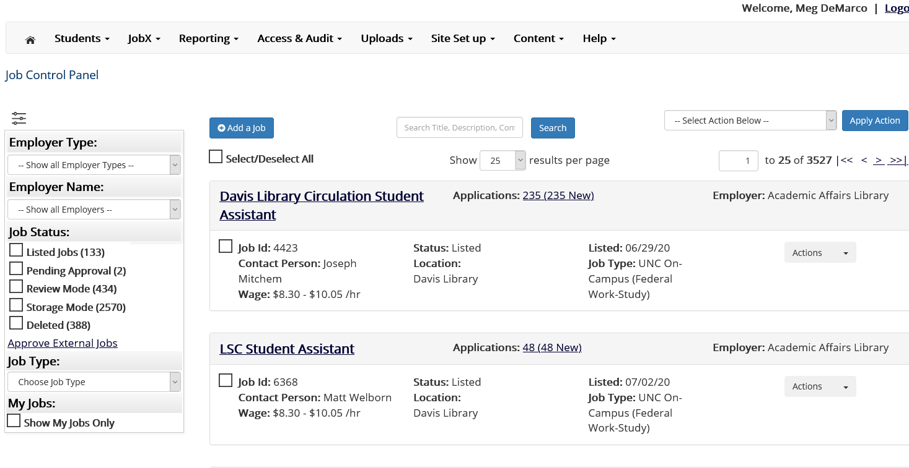
Accessing Jobx
After you login you will be on the Job Control Panel
You can see your active, pending, and previously ended positions
Notes:
Take time to explore the site. Review the “Help” function for information not covered in this training but you may be interested in.

Slide 8
b) Posting NEW* positions
Supervisor Link
Notes:
If you are a returning WS Supervisor who will not be creating new positions, you may skip to the next section: Updating positions from a previous year.

Slide 9
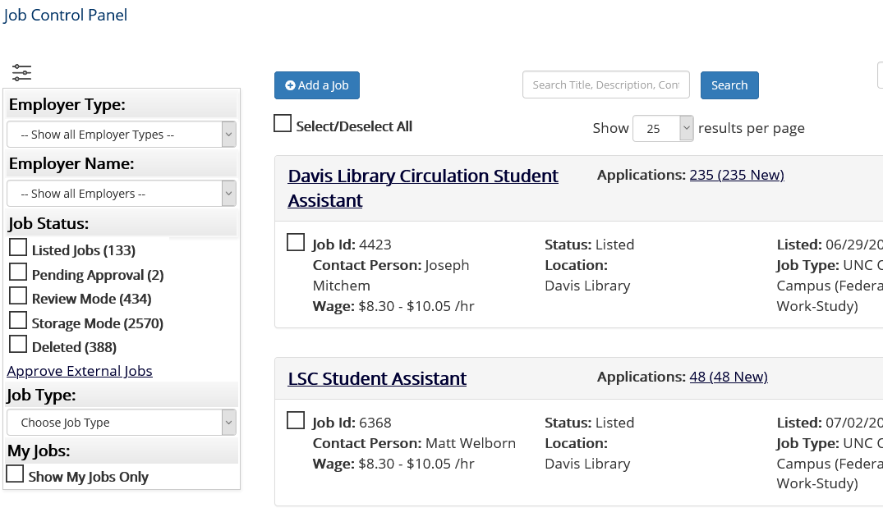
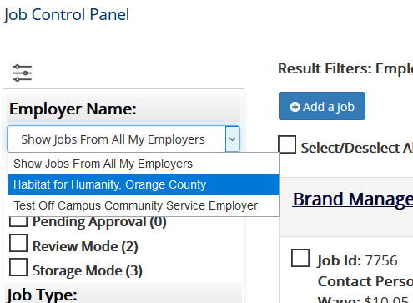
b) Posting new positions
On the Job Control Panel:
Select your employer (i.e. your Off-Campus Agency Name) in the dropdown list on the left, if it is missing email work-study@unc.edu.
Press the “Add a Job” button after.
Notes:
If you are a returning WS Supervisor who will not be creating new positions, you may skip to the next section: Updating positions from a previous year.
If you ever forget, the text at the top of the page will remind you how to add a job!

Slide 10
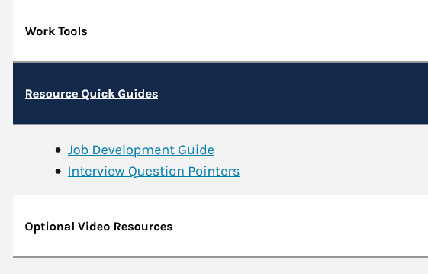
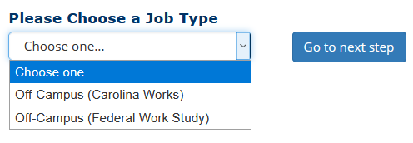
b) Posting new positions
1. Next, Select the “Job Type” you wish to list the position as, then hit the “Go to next step” button
2. Review the Job Profile Guide under Supervisor Resources and start your Job Profile
Notes:
Selecting the WS Program allows an employer to determine whether the position is being posted for the Federal Work-Study (FWS) or Carolina Works (CW) program. If you are unsure of the difference, please review the WS Supervisor Training presentation for more information.
Guide development guide link https://studentaid.unc.edu/wp-content/uploads/sites/1072/2021/03/Job_Development_Guide.pdf

Slide 11
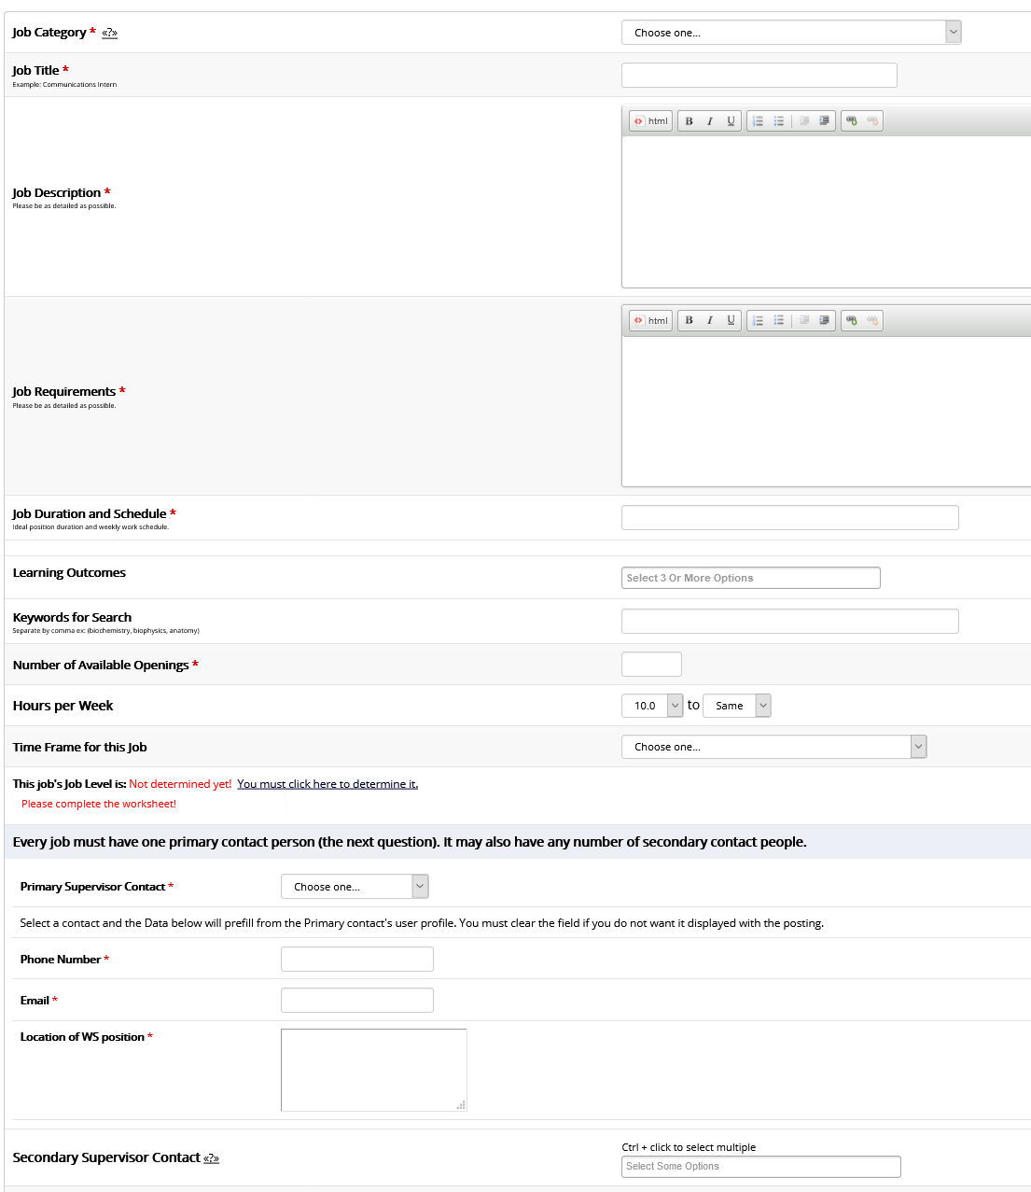
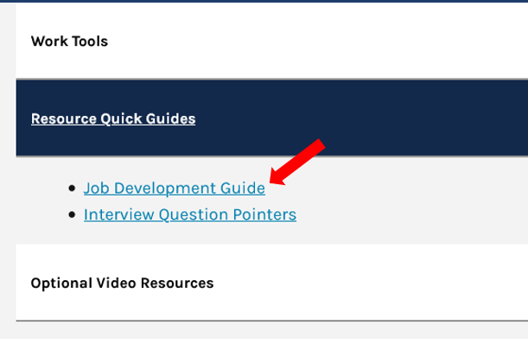
b) Posting new positions_Job Profile
Have the job Development guide up as we go
through each of the sections!

Slide 12
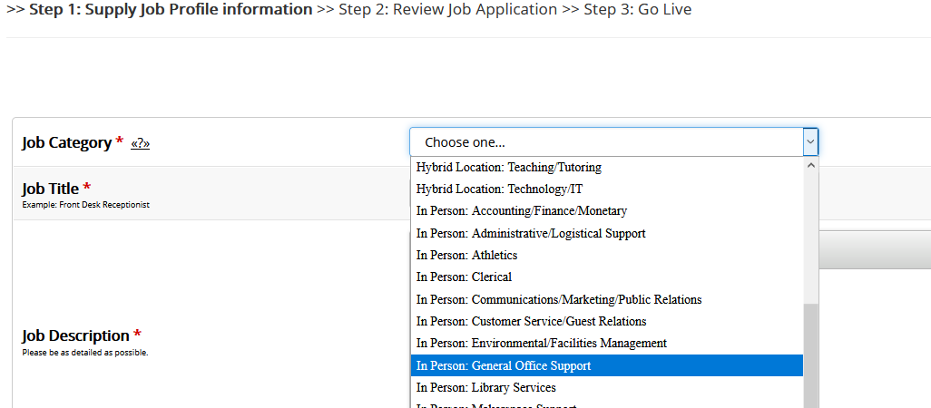
b) Posting new positions_Job Profile
Part 1: Select Job Category
In Person: Job is completely performed In-Person
Hybrid: Student’s location will vary from working virtually or In-person
Virtual: Job is completely performed virtually
Notes:
A selection of several job categories which allows students to search for jobs by a particular position type. The list varies with the WS Program and employer type
Example: a position washing glassware & assisting with equipment in a research laboratory would utilize the “Research (Support)” option

Slide 13
b) Posting new positions_Job Profile
If you're posting a Federal Work Study position that is eligible for the 100% cost share match, you must request to post the positing prior by speaking with Meg DeMarco and you MUST select either:
Hybrid Location: Tutoring, Family Literacy Community Service
In Person: Tutoring, Family Literacy Community Service
Virtual: Tutoring, Family Literacy Community Service
Eligible Positions:
the student is employed as a reading or mathematics tutor for preschool age children or children who are in elementary school;
the student is performing family literacy activities in a family literacy project that provides services to families with preschool age children or children who are in elementary school;
the student is employed in community service activities and is performing civic education and participation activities in a project as defined in 34 CFR 675.18(g)(4).
Notes:
A selection of several job categories which allows students to search for jobs by a particular position type. The list varies with the WS Program and employer type
Example: a position washing glassware & assisting with equipment in a research laboratory would utilize the “Research (Support)” option

Slide 14
b) Posting new positions_Job Profile
Part 2: Job Title
Make it something that will be powerful on a growing resume
Promote Management, Responsibility, and Skill to gain interest
Notes:
The official title of the position that you would like displayed to students. In many cases this is also the official position title used with Human Resources, but it can also be a less official description.
Example: a position washing glassware & assisting with equipment in a research laboratory might use the title “Laboratory Maintenance Technician I” or “Student Worker in Research Lab”
Students may look through dozens of job postings before selection one for application. Try to make your name representative of the position and its duties rather than a generalization. For example, “Davis Library Rare Books Collection Assistant” is much better at attracting applicants than “Student Worker in Library”.

Slide 15
b) Posting new positions_Job Profile
Part 3: Job Description
Part 4: Job Requirements
List the skills students will gain under learning outcomes on the Job Development Guide!
Knowledge:
Student must understand laboratory equipment or agree to learn from other lab members
Skills:
Excellent organization skills
Basic skills with ProMed research tool and Microsoft Excel or willingness to learn
Abilities:
Student must be able to stand at a workbench and lab sink for extended periods of time
Other:
Must be willing to always wear proper safety equipment
2. Must have Laboratory Safety certification or will be willing to complete before starting in the position

Slide 16
b) Posting new positions_Job Profile
Part 5: Job Duration and Schedule: Describe Timeframe/Scheduling /Flexibility
Part 6: Learning Outcomes
Professionalism & Work Ethic
Career Management
Creativity & Problem Solving
Global Perspective
Communication
Technical Application
Teamwork, Collaboration, & Leadership
List 3 or more learning outcomes students will develop by working in this
position based on the list of skills on the Job Development Guide!
These are crucial for our students in developing their resumes and
enhancing their future careers
Notes:
Part 5: Scheduling and flexibility of hours
Part 6: Learning Outcomes
This section allows you to list 3 or more skills students will develop by working in this position. JobX provides a list of over 130 skills across 8 areas University Career Services Identifies as the most desirable areas for employers:
Professionalism & Work Ethic
Career Management
Creativity & Problem Solving
Global Perspective
Communication
Technical Application
Teamwork, Collaboration, & Leadership

Slide 17
b) Posting new positions_Job Profile
Part 7: Keywords for Search: Separate by comma and add key words and areas students may search for when looking for a position
Part 8: Number of Available Openings: How many students do you plan on hiring in this exact position with these same specifications?
Part 9: Hours per Week: How many hours do you want your students to work? Max number of hours is 20 per week, the average is 10-12
Remember most students have WS awards of $2,700-$3,300 which allows them to work 6-17 hours per week
Notes:
Keywords for Search
The keyword search section was developed in response to requests from students and supervisors for a better search tool. Employers can use a list of key phrases prefixed with a # to help students easily find positions relevant to them. For example, employers looking for students interested in Chemistry can use “#Chemistry” as a key search term. Before, this search would have yielded jobs located in the Chemistry Buliding, with the Chemistry department, and even employers with the last name Chemistry.
Number of Available Openings
One job profile can be used to hire multiple employees, streamlining your application review process. Keep in mind you’ll need to file multiple job profiles if the program, description, requirements, hours, or pay differs between openings
Hours Per Week
Ranging from 0 to 20 (the max allowed under program regulations), this field lets you set the expected minimum and maximum number of hours per week a student will work. The average values vary greatly between positions, but most students actually work an average of 10-12 hours per week.
Make sure number on right is bigger than the number on the left.

Slide 18
b) Posting new positions_Job Profile
Part 10: Time Frame for this Job: Define whether the position is for the
Summer Carolina Works
FWS Academic Year= only FWS students can apply
CWS Academic Year= only CW students can apply
Fall Only (FWS+CW) = both groups of students can apply
Spring Only (FWS+CW)= both groups of students can apply
All students who are enrolled in the summer, have financial need, and complete the summer request form are eligible for summer Carolina Works award (regardless of if they are a FWS students during fall/spring)

Slide 19
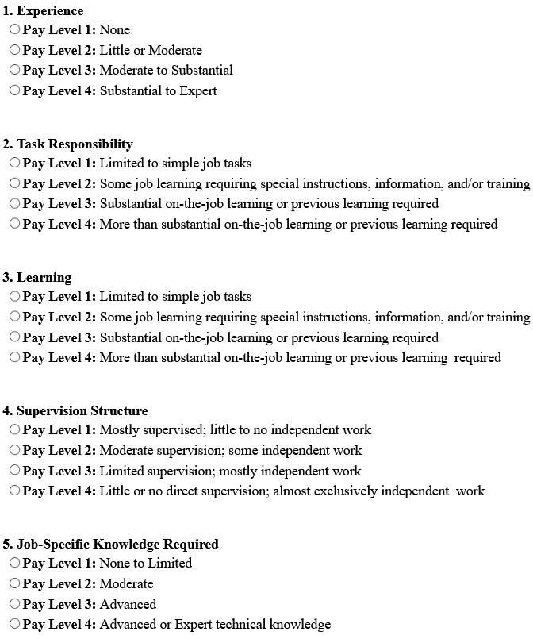
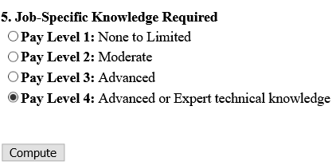
b) Posting new positions_Job Profile
Part 11: This Job’s Level is:
Select the link to determine the Job Level and corresponding pay
Answer the 5-question assessment
Select “Compute”
Close the window and continue to the next section

Slide 20
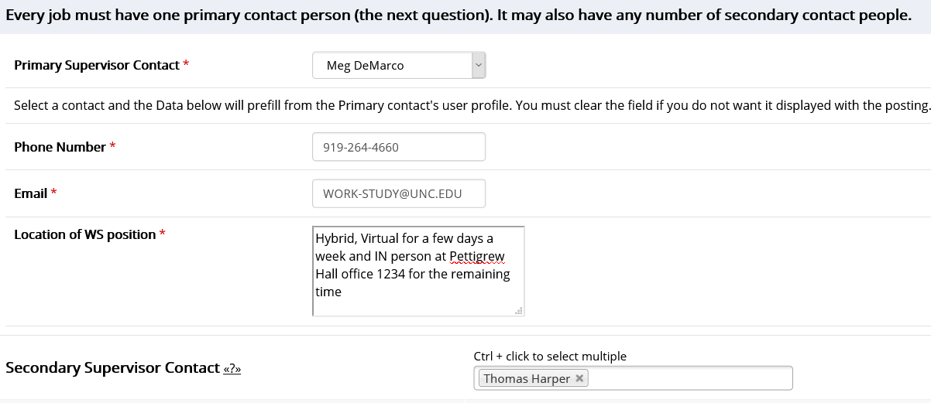
b) Posting new positions_Job Profile
Part 12-16
Select your name as the primary supervisor. Then your phone number, email, and the location of the position.
It is recommended you have a secondary supervisor listed but not required
Submit!
If Virtual just insert “Virtual” here!
Notes:
Primary Contact Information (person, phone, fax, email, location):
Provide information on who is in charge of the application review, interview, selection, and supervision processes. In almost every case, this will be you. As such, the system will autofill most of this information for you based on your JobX Profile.
Secondary Contact People
If your JobX Profile is associated with another user (e.g. you both work in the same departments), you can add them with the posting here as a secondary supervisor. This will allow other users to assist in the administration of the application, search, & hiring functions in JobX as well as legitimize their ability to supervise students in the position. To select someone, highlight their name and click the [Add>>>] button.

Slide 21
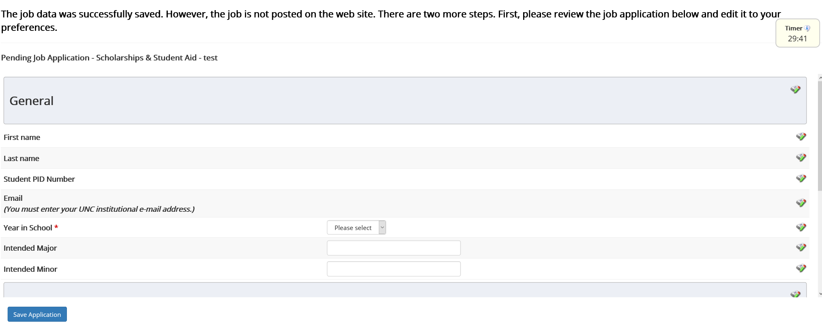
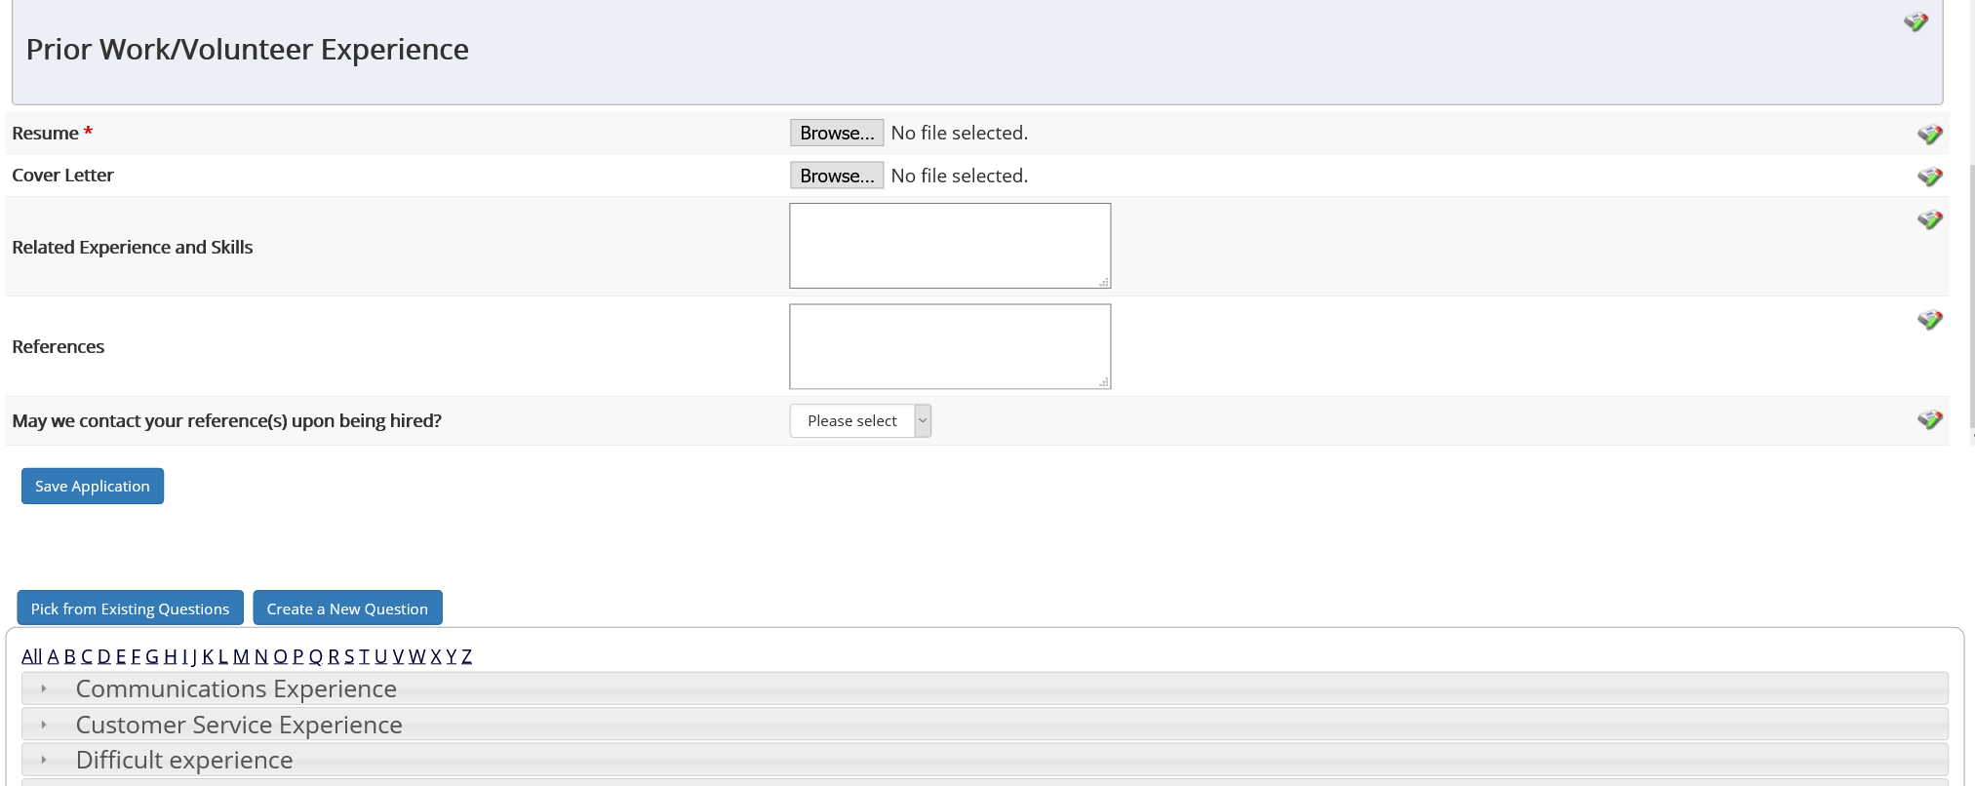
b) Posting new positions
Pending Review
On this page you review the standard job application students will fill out when applying to the position. You may add required questions at the bottom or leave as the standard template shown!
You have 30 minutes
To review and post your position from this point!
Select the pencil to reorder, add additional options for the questions, or remove any you do not need
Custom application questions allow you add your own custom questions to the job application. If you wish!
More guidance is in this slide's notes
Notes:
Common Application includes several required fields (student name, PID, email, year in school) and a voluntary field (major)
Common Application Questions-Prior Work/Volunteer Experience contains a space for students to include their resume & cover letter as well as provide information about former employment and references
Custom application questions allow you add your own custom questions to the job application.
You also have the option to create custom application questions to add to your job posting. While we’d strongly encourage you to create questions for areas related to required job duties (i.e. checking for certifications and experience), please keep in mind that there are questions interviewers and supervisors can not legally ask (e.g. do you have children). If you need help determining the legality of your question, please check with your HR Department. This section has two tabs: Pick from Existing Questions & Create a New Question
Pick from Existing Questions allows you to add a question that you’ve already created in another job application. This is helpful if you’ve already set up your question in a previous year or another application in the current year.
Create a New Question, lets you do exactly that using a new menu in two parts.
Question Details allows you to choose the type of question from a given list including text, date, choice questions, file upload, and instructional text; the last option is extremely helpful if you’d like to relay a message to job applicants.
Once you’ve selected the type of question, the page will reset to provide data capture options that best fit the question format.
All options require the following fields
Question Name
Question Label
Additionally, you may be asked to provide the following data
Default Value
Regular Expression
Require Confirmation
Question Choices
Application Behavior governs where the question is placed. You can choose to locate the question in a new section or one of the existing sections. The first two boxes determine in which section you’d like to place the question; the last determines the question’s order within the section.
***Once you’ve finished creating your question, don’t forget to click the [Add Question] button ***

Slide 22
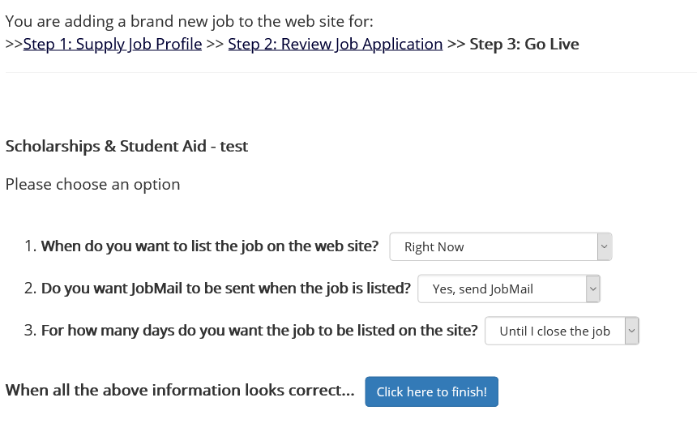
b) Posting new positions_Go Live!
1. When do you want to list the job on the web site?
You’ll want to have the job posted immediately in most cases.
2. Do you want the position to be eligible for JobMail, where students are notified of positions in their interests' areas?
While not required, we recommend enabling JobMail so applicants can find your job more easily.
3. For how long do you want the job posted?
This question is entirely up to you. Most users leave the position posted until they chose to close it.
The position will automatically close if all openings are filled; additionally, the WS Team will close all open jobs at the end of the year.
*Select Finish! You’ll be presented with the options of viewing the job or returning to the control panel. Your job will be pending as the WS team reviews! Once we approve, the position will be live.
*After the job has been posted, you can still edit the details of the job description from your control panel.
Notes:
Pro Tip: Viewing the job details is a great way to proofread, see what applicants will see, and provides you with an opportunity to save a copy of the description for your records & future years.
To edit the job profile from step 1, use the “Edit Job” option in the dropdown menu.
To edit the questions from step 2, use the “Manage Application” option in the dropdown menu.
To review the position/application details, request that the job status be changed (e.g. to have the job reviewed after making edits), or any of the other manager functions click on the job title (Red Hyperlink).
***Please note that updating any portion of the job posting will require the position to be reinspected
before it will become visible to applicants.***

Slide 23
b) Posting new positions_Approved
Once the review process has been completed and the job is listed, you’ll notice that the position will change from the “Pending Approval” section to the “Listed” section.
Notes:
Pro Tip: Viewing the job details is a great way to proofread, see what applicants will see, and provides you with an opportunity to save a copy of the description for your records & future years.
To edit the job profile from step 1, use the “Edit Job” option in the dropdown menu.
To edit the questions from step 2, use the “Manage Application” option in the dropdown menu.
To review the position/application details, request that the job status be changed (e.g. to have the job reviewed after making edits), or any of the other manager functions click on the job title (Red Hyperlink).
***Please note that updating any portion of the job posting will require the position to be reinspected
before it will become visible to applicants.***

Slide 24
c) Updating previous positions
Supervisor Link
*You can only update positions that were originally listed in the corresponding academic period for which you plan to repost. For example, if you originally posted a position in the Fall- you can update and repost for any following Fall semester but cannot repost the original Fall position in the Summer. You would need to create a new summer posting.

Slide 25
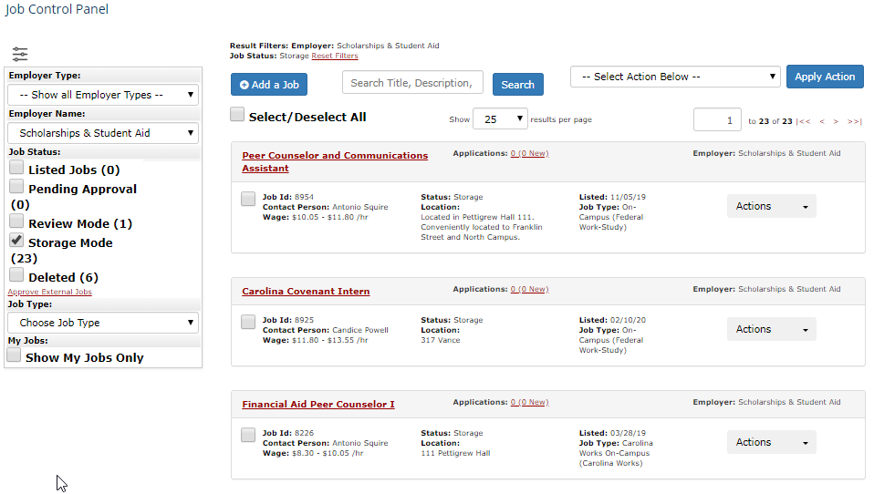
c) Updating previous positions
1. On your landing page, click the storage mode filter to show the jobs currently in storage.
2. Once your job(s) has populated click on the title of the position to enter job manager screen.

Slide 26
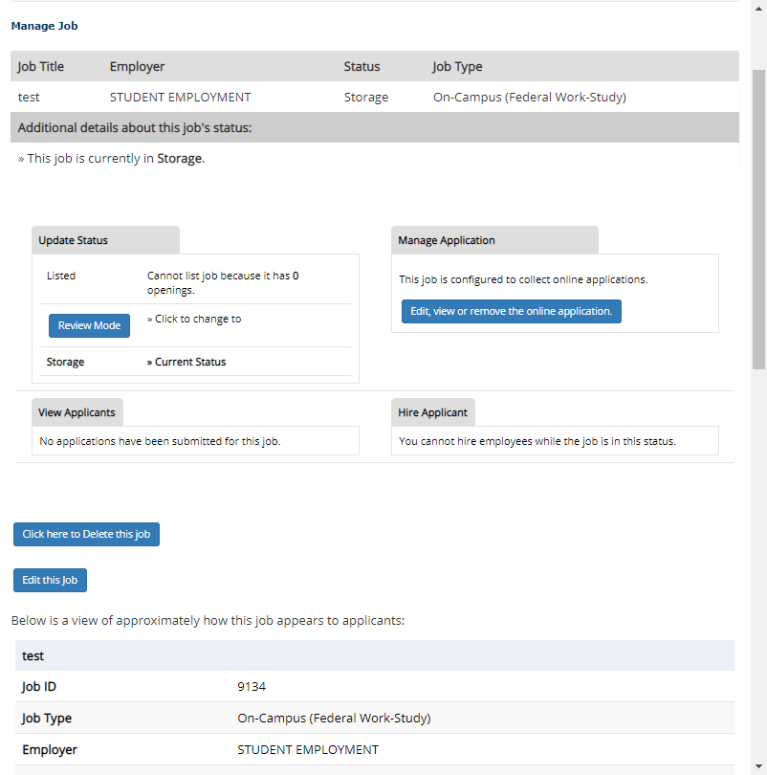
c) Updating previous positions
1. The job management screen consists of 6 sections:
A position overview of the job at the top including the title, employer, and status.
Update Status section
A “Manage Application” section
A pair of sections to view and hire applicants
A job preview section
Jobs moved into storage from previous years will have zero openings by default. In order to add jobs, you will need to use the [Edit this Job] link to open the Update Job Profile page.
Once the Update Job Profile Page is open, you will need to update the total number of jobs. If you plan on rehiring students from the previous year, you will need to account for both returning and new student workers
Notes:
Pro Tip: This is an excellent opportunity to review and update all portions of the Update Job Profile page to ensure you are attracting the best applicants possible. Sparse, clunky, or confusing posts receive fewer applicants as job-seekers simply stop reading the post and move on.

Slide 27
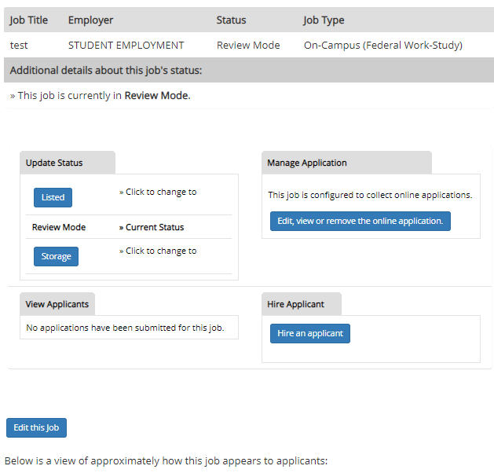
c) Updating previous positions
You will update the Job Profile now! Follow the steps on slides 11-19 for how to complete a Job Profile Review and open the Job Development Guide
Once you have finished updating the Job Profile, Save the updated position and you will be returned to the Manage Job Screen where you must edit the application questions before your posting is live!

Slide 28
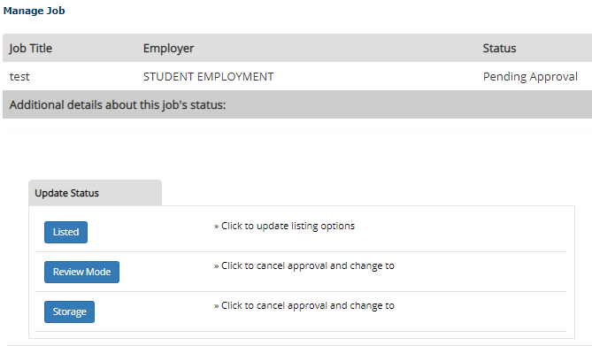
c) Updating previous positions
At this point you must submit the position for inspection by clicking on the Listed link in the “Update Status” Box.
Sending the position to any other status will not result in it being inspected, and applicants will not be able to view the position on JobX. The position “Update Status” should read “Pending Approval” if this step is done correctly.
After the job has been posted, you can still edit the details of the job description from your control panel.

Slide 29
c) Updating previous positions_Approved
Once the review process has been completed and the job is listed, you’ll notice that the position will change from the “Pending Approval” section to the “Listed” section.
Notes:
Pro Tip: Viewing the job details is a great way to proofread, see what applicants will see, and provides you with an opportunity to save a copy of the description for your records & future years.
To edit the job profile from step 1, use the “Edit Job” option in the dropdown menu.
To edit the questions from step 2, use the “Manage Application” option in the dropdown menu.
To review the position/application details, request that the job status be changed (e.g. to have the job reviewed after making edits), or any of the other manager functions click on the job title (Red Hyperlink).
***Please note that updating any portion of the job posting will require the position to be reinspected
before it will become visible to applicants.***

Slide 30
d) Review, reject, and interview applicants
Supervisor Link

Slide 31
d) Review, reject, and interview applicants
Once students begin applying for your position, you’ll notice that the information under the App# field will change from 0. The updated information will provide both the total number of applications and the number of unreviewed applications.
To review the applications, click the hyperlink next to the “Application” text. This will take you to the applicant review screen.
You should now be able to see a list of applicants who applied to the position as well as have access to a variety of tools to assist you in evaluating the student’s application and communicating with the student
To view the student’s applications, click on their name or click/hover on the magnifying glass symbol
To flag the student for further consideration, click on the flag symbol
If the student submitted a resume, you will be able to view it by clicking on the entry in the “Resume” column
To email the student (e.g. to offer an interview) click on the envelope and pen icon
To print a copy of the application, click the print icon
The “Delete” & “Hire” links on the right allow you to delete or hire students, which we’ll cover shortly

Slide 32
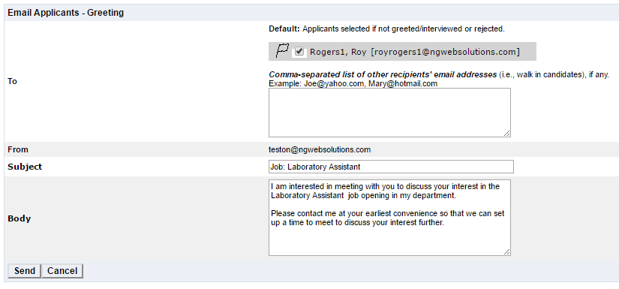
d) Review, reject, and interview applicants
Once you’ve selected the student(s) you are interested in hiring, you will need to conduct an interview
To send the interview notice:
1.Check the box next to the student(s) you wish to notify
2. Click the “Send Greeting” option from the dropdown
3. Click the [Apply Action] button.
This will open a new prepopulated email window.
The student address, subject line, and body are prepopulated, but the text can be edited to fit your needs.
Once you’ve updated the message to your specifications, click the [Send] button & JobX will handle the rest.
3
1
2

Slide 33
d) Review, reject, and interview applicants
Interviews are mandatory for new hires.
You are not required to interview students if they worked in a substantially similar position previously.
Interviews can be conducted in person, via phone, or over the internet using programs like Zoom or Skype. Given that many applicants will apply before they move to campus or will work exclusively online, planning for telephone/internet-based interviews is recommended.
Interviews provide an invaluable opportunity to evaluate the student’s communication and interaction skills as well as gain insight into the motivations and character of the applicant.
It is helpful to consider how the personality of this candidate might fit with the other members of your team when speaking with the student.
Be mindful that some seemingly innocuous questions are off-limits during an interview (e.g. Would your spouse or children affect your work schedule?). Review our interview tips prior to scheduling

Slide 34
d) Review, reject, and interview applicants
You are REQUIRED to respond to every applicant, even if you do not wish to interview them. Students are limited in the number of applications they can file. As such, we ask supervisors to release those students they do not wish to interview/hire so that the students can apply for other positions.
To send the rejection notice:
1.Check the box next to the student(s) you wish to notify
2. Click the “Send Reject Email” option from the dropdown
3. Click the [Apply Action] button.
This will open a new prepopulated email window.
The student address, subject line, and body are prepopulated, but the text can be edited to fit your needs.
Once you’ve updated the message to your specifications, click the [Send] button & JobX will handle the rest.
3
1
2

Slide 35
e) Selecting and Hiring
Supervisor Link

Slide 36
e) Selecting and Hiring
Once you have selected a candidate(s) to hire, you are required to extend an offer of employment prior to hiring the student
Job offers can be distributed through email, via phone, in person, or through any means you see fit, though we highly recommend an email offer.
As a best practice, you’ll want to include the following items in your offer.
The name of the position
The academic term(s) during which the student will be employed
A wage rate and expected number of hours per week
A deadline by which the applicant needs to give you their decision
A method by which the applicant can reach out if they have questions
Once your offer has been accepted, you’ll need to update JobX to officially hire the student
Students hired without authorization through JobX will not be considered for Work-Study reimbursement through the voucher system.
You can find a Hiring Letter Template on the Supervisor Resources Site.

Slide 37
e) Selecting and Hiring
Hiring for multiple vacancies? You don’t have to wait until all spots are filled to begin the hiring process. Example: you have 4 vacancies; you can hire 3 students and leave the position open to gather resumes for the 4th
To hire a student in JobX, start by going to your landing page.
Once there click on view applicant data by clicking on the hyperlink beside the “Applications” header.
From here, click the “Hire Applicant” option in the dropdown.
This will open up the hire page, on which you’ll want to click the [Go to step 2] button. This will open a new page on which you’ll certify the student’s information and then click the [Check Student] button.

Slide 38
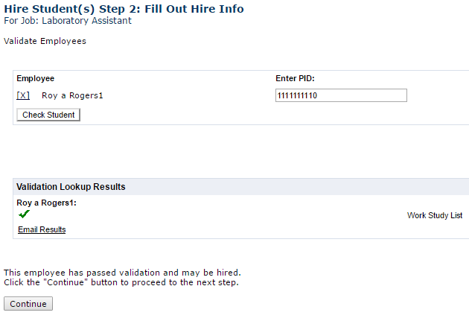
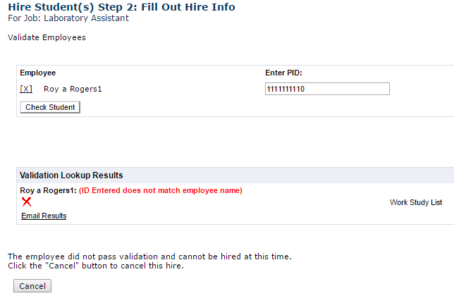
e) Selecting and Hiring
The system will then attempt to validate the student to confirm that they have a work-study award.
Students who pass validation will have a green check mark and a [Continue] button populated.
Clicking the [Continue] button will advance you to the “Fill Out Hire Info” screen
Students who do not pass validation will have a red x and a [Cancel] button populated. If this occurs, you’ll want to confirm the student’s PID and that they have a work-study award.

Slide 39
e) Selecting and Hiring
Once your applicant passes the hiring check and you elect to continue, your system will begin a process timer. Leaving the system inactive for more than 10 minutes or failing to complete the process within 30 minutes will prevent you from properly completing the hiring process and sending an official hire email from JobX.
These emails can not be generated a second time without terminating & rehiring the student.
Please take note of the information on the following slides so that you can proactively gather the necessary information and avoid the time-out issue.

Slide 40
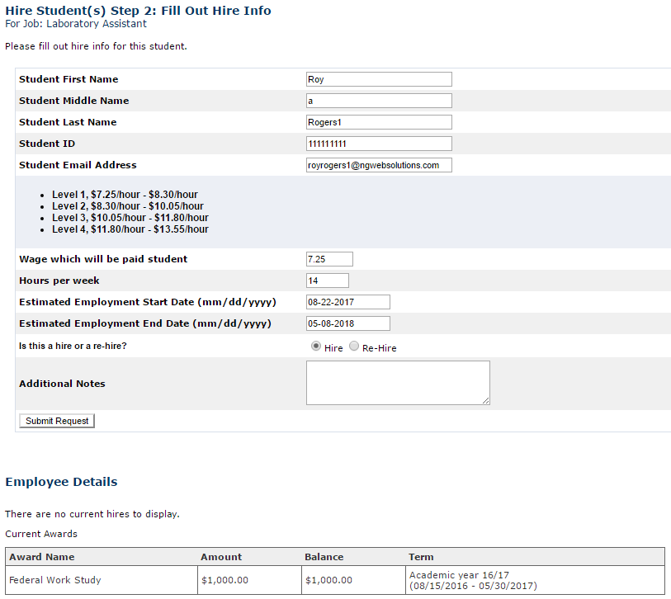
e) Selecting and Hiring
On the “Fill Out Hire Info” screen you will finalize the position details for the individual student. To complete this screen, you’ll need to complete the following fields.
Pro Tip: Don’t forget to go back and send reject letters for those applications you did not select, otherwise those applicants may bombard you with requests for updates on the position.
Notes:
Confirm that the student’s biographical and contact information is correct.
Input the student’s hourly wage rate. This rate has to fit within the job level you chose for the position and will be reviewed.
Input the expected hours per week. This figure is an approximation and can vary from week-to-week with supervisor approval.
Confirm the estimated employment start day and end date. These dates should default to the correct values for the time frame selected during the job creation process.
Indicate whether the student is being hired for the first time or rehired to the same position they held in the previous year.
Provide any additional relevant notes.
Click the [Submit Request] button

Slide 41
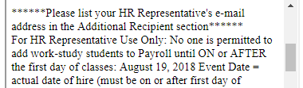
e) Selecting and Hiring
On the “Email Hire Approval ” screen you will finalize the position details for the individual student. To complete this screen, you’ll need to complete the following fields.
1.Select the appropriate recipients. In most cases, we recommend
sending it to “Both” which includes a confirmation of the hiring for yourself
and the applicant.
2. Copy the email for your HR Officer if applicable in this field so
that they will receive the information necessary to hire them
3. Click the [Email Hire Approval] button.

Slide 42
f) On-Boarding Process
Supervisor Link

Slide 43
f) On-Boarding Process
The Work-Study Supervisor is responsible for both assisting the student with hiring tasks and ensuring the tasks are completed prior to the student’s first day of work.
Hired WS students must complete all required payroll forms with the hiring department’s HR representative before they can begin working. To expedite this process, you should email your HR Representative (and cc the student) to set up an appointment for the student, preferably before the first day of work (in case the student has to make multiple appointments).
You should also notify the student that they will need to complete any required forms such as :
NC-4
W-4
Direct Payroll Deposit Authorization
Electronic I-9 Employment Eligibility Verification
Students will need to bring documentation to this and it’s best to cover this possibility with the student as early as possible after hiring the student to minimize delays.

Slide 44
f) On-Boarding Process
You will also need to complete the following tasks with the student
Show the student how to fill out the sign-in/sign-out sheet for the position.
Give the student a tour of the work area.
Introduce the student to coworkers and secondary supervisors.
Explain the student’s job responsibilities in more detail.
Review the evaluation form.
Discuss and provide the student with a written copy of their duties, goals, & expectations.
Your may also choose to provide recommended on-boarding such as:
Reviewing position expectations and office norms
Setting up evaluation periods
Discussing additional training opportunities
Asking the student to complete job-specific privacy training

Slide 45
f) On-Boarding Process
Before students can begin work, they’ll need to provide you with documentation that they successfully completed Work Study Student Training. You’ll need to obtain a copy of the student’s assessment for that current academic year showing a score of 100%.
These document can be submitted to you electronically or via paper copy at your discretion.
If requested, you will need to provide these documents to the Work-Study Team.
Beginning August 2, students may begin work only if all set-up steps are complete.
Please do not let students begin work until all Payroll & WS Training processes are completed!
Allowing students to begin working before school begins and/or payroll and training verification have been completed can result in cost share reimbursement being withheld to your organization and/or removal from the work-study program.
Follow the on-boarding checklist under supervisor resources to help prevent an errors from occurring!

Slide 46
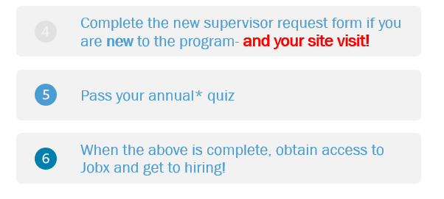
Thank you for Completing the Off-Campus Jobx Training. Next steps include:
Notes:
Huey, AKA Hubert A. DeMarco, the first of his name. Can be found in Pettigrew hall for pets and walks. An exclusive offer for WS students and supervisors.

