Slide 1
Work-Study
On-Campus Supervisors
Regulatory Training
21-22
Notes:
This presentation is for ALL Supervisors training on Work-Study regulations and guidelines. This training is required for any supervisor participating in work-study and must be reviewed at the beginning of each academic year.

Slide 2
Additional information for each slide will be in the slide notes if you need a more detailed explanation

Slide 3
Annual Supervisor Requirements New and Returning*
Review regulatory training (Here! You made it!)
Review the program calendar and website resources
Review Jobx Training
Complete the new supervisor request form if you are new to the program
Pass your annual* quiz
When the above is complete, obtain access to Jobx and get to hiring!
Notes:
Regulatory training is specific for on vs off campus supervisors
Review Program Calendar and Website Resources
Jobx training for ON campus supervisors, not the Jobx training for off campus supervisors
New supervisor request form for new and replacement supervisors to complete once
Pass the annual quiz!
Jobx Access granted

Slide 4
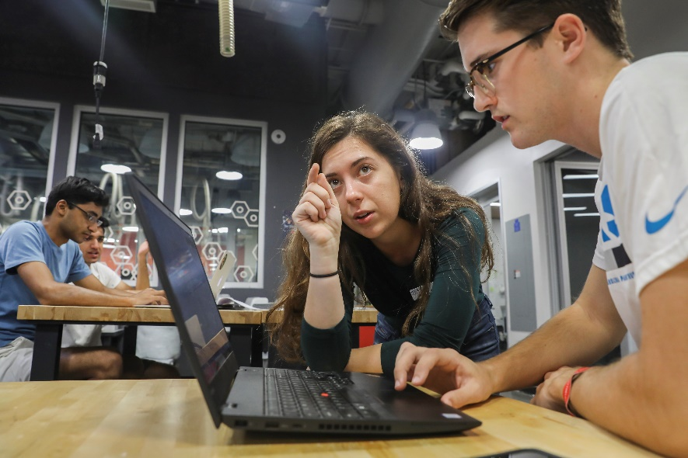
Federal Work-Study Program
FWS is a Title IV financial aid program that provides part-time employment opportunities to students who demonstrate financial need
Students must apply for FWS by submitting a Free Application for Federal Student Aid (FAFSA), or by requesting it through our WS office if they demonstrated financial need and funds are available
At the start of each fiscal year, students are notified of their FWS eligibility as part of their year-specific financial aid package. FWS is awarded on an annual basis, students reapply and requalify each year
Employer wage match is 30%, OSSA will pay 100% of student's up-front wages per pay period, after reconciliation OSSA creates invoices for wage share through the CBM system
Notes:
Only those students who have been awarded FWS may participate in FWS employment opportunities
CBM will process all pending invoices on the 14th of the month. Departmental business officers then have until the 22nd to adjust billing to a non-default funding source (if needed).
Additional information on this process can be found here:
https://unc.studentemployment.ngwebsolutions.com/cimages/CBM_Dept_Default_Setup.pdf
https://ccinfo.unc.edu/resource-docs/using-the-customer-billing-management-cbm-system/

Slide 5
Federal Work-Study Program
Employment can be on-campus (with offices, departments, professional schools, auxiliary services) or off-campus with approved non-profit community service agencies. Both remote and in-person per the supervisor's preference
FWS is supported by a combination of federal, state, and institutional funding and is subject to the regulations imposed by all three
FWS helps defray the cost of higher education by enabling students who are disproportionally affected by poverty or other outstanding circumstances to earn a steady paycheck and reduce/minimize loan debt

Slide 6
Carolina Works
Carolina Works (CW) provides a work-study opportunity to economically-disadvantaged students who do not meet the financial need level required to join the FWS program
CW operates under the same structure as the FWS program, is overseen by the same staff, and uses the same technical/logistical systems
Supervisors who qualify for FWS can also participate in the CW program and can hire both sets of students for the same jobs
Students' participation is mutually-exclusive between FWS and CW programs
Employer wage match is 50%, OSSA will pay 100% of student's up-front wages per pay period, after reconciliation OSSA creates invoices for wage share through the CBM system
Notes:
CBM will process all pending invoices on the 14th of the month. Departmental business officers then have until the 22nd to adjust billing to a non-default funding source (if needed).
Additional information on this process can be found here:
https://unc.studentemployment.ngwebsolutions.com/cimages/CBM_Dept_Default_Setup.pdf
https://ccinfo.unc.edu/resource-docs/using-the-customer-billing-management-cbm-system/

Slide 7
Work-Study Programs
Work-study award amounts may be revised/reduced (due to a student receiving undeclared funding); hiring supervisors will be notified of any update via a weekly report and students should report outside funding to supervisors upon receipt
Students are assigned an hourly wage rate set by the employer and are paid on a biweekly basis via direct deposit
Notifications will be sent to the student & supervisor once the student nears their award limit
Earnings in excess of the award amount become the responsibility of the hiring department
All FWS and CW positions must receive approval by the Office of Scholarships and Student Aid (OSSA) and be posted to the JobX database to ensure eligibility. Positions are required to provide students with opportunities to develop professional skill sets and correspond with academic, professional, and personal interests
Notes:
Students hired without authorization through JobX will have their earned wages retroactively charged to the hiring department.

Slide 8
Eligible Work Periods
Students must be actively enrolled
to work
Fall Semester | Work may begin on the first day of the first payroll following summer work-study operations and must stop on/before the last day of fall exams for Fall-only positions and students who are not enrolled in the Spring term
Winter Break | Work between semesters is ONLY ALLOWED for students enrolled in both Fall & Spring classes who are employed in a WS position for Fall & Spring
Spring Semester | Work may start on the first day of spring classes for Spring-only students and must stop on/before the last day of spring exams for all Fall & Spring and Spring-only positions
Summer Terms | FWS funding is not available for Summer CWS program funding remaining at the end of Spring can be used to fund a summer work-study program. Notifications are released in mid Spring if funding is available
Student Breaks | Students may work during intra-semester breaks provided a registered supervisor is present when student is working
University Holidays | Work IS NOT permitted during university holidays when departments are closed. If the department is open and a registered WS Supervisor is present, students can work during university holidays on a voluntary basis
Notes:
Reminder: a registered supervisor must be present any time a student is at work

Slide 9
Only (a) full-time, permanent, faculty and staff, (b) approved nonprofit community service partners, and (c) temporary employees with an employment expiration date later than the end of the student’s employment term may supervise students through the WS program
Graduate students and part-time employees are not eligible to be WS Supervisors
The primary supervisor must be registered on JobX as the position manager. An unlimited number of other supervisors can register as secondary supervisors
We strongly recommend having a one or more secondary supervisors for times when the primary supervisor is unavailable (e.g. ill, in meetings, on vacation). If the primary supervisor is absent and no secondary supervisor is listed, students can not work
If a WS supervisor leaves, we must be notified to be able to communicate with the department and update Jobx. Notify WS by email right away and have the new supervisor complete the new supervisor request form
Supervisor Eligibility and Changes
Notes:
It is highly advisable that employees without supervisory experience receive appropriate training and/or experience prior to serving as a WS Supervisor
If a supervisor leaves their position or is no longer able to manage student workers, another supervisor must replace them in the JobX system.
If a department has students working without a valid supervisor (who must registered as such in JobX), student earnings will be retroactively charged to the department.

Slide 10
Eligible Jobs
Students may hold only one WS position at a time but may be simultaneously be employed in other non-WS positions
Students are part-time employees and are not permitted to work more than 20 hours per week. 10-12 hours per week is average
Driving is not permissible as part of a FWS job– this includes state vehicles and personal vehicles
Studying is strictly prohibited while on the job: work-study is not a form of paid study time
Students are required to document their attendance, usually through a sign-in/sign-out protocol involving the TIM system. Supervisors are required to verify that the student was working during recorded times

Slide 11
Job Classification
In compliance with federal regulations, OSSA has established a Job Classification System (JCS) to assist supervisors with determining equitable compensation based on job requirements
The JCS differentiates among knowledge, skill level, ability, and recognizes the wide array of job responsibilities
The JCS permits supervisors to equitably classify students based on the level of complexity of the job and qualifications of the individual student across the entire WS program
We have embedded a tool on the job posting page to help you determine a fair compensation rate for your WS student. Simply select the options that are most representative of your WS student, and we will use that information to suggest a fair compensation rate.
Notes:
Need to add links/ update the links!

Slide 12
Pay Rates and Levels
Level 1 ($7.25-$8.30)
No experience/previous training required;
Position performs routine tasks with minimal responsibility; Position may require demonstrated ability to successfully interact with the public;
Student employee works in a well-supervised setting/takes little-to-no independent action
Level 2 ($8.30-$10.05)
Little or moderate experience, technical knowledge, or previous training is necessary;
Special instruction may be necessary for some aspects of position; Student employee must demonstrate ability to learn new tasks and work independently with moderate/limited supervision
Level 3 ($10.05-$11.80)
Moderate to substantial experience, technical knowledge, or previous training/certification necessary; Student employee possess high level of competency with specialized skill and readily demonstrates independent judgment, decision-making ability, and/or the ability to work responsibly with little-to-no direct supervision;
Previous work experience at a lower level within the same department may be required
Level 4 ($11.80-$13.55)
Level 3 scope plus position requires an individual who possesses substantial experience, advanced technical knowledge, and previous training/certification; Student may be expected to manage technologies/equipment, research, analyses, publications, instruction, or other special projects or activities of significant scope ;
Student may work with extremely limited supervision on a regular basis

Slide 13
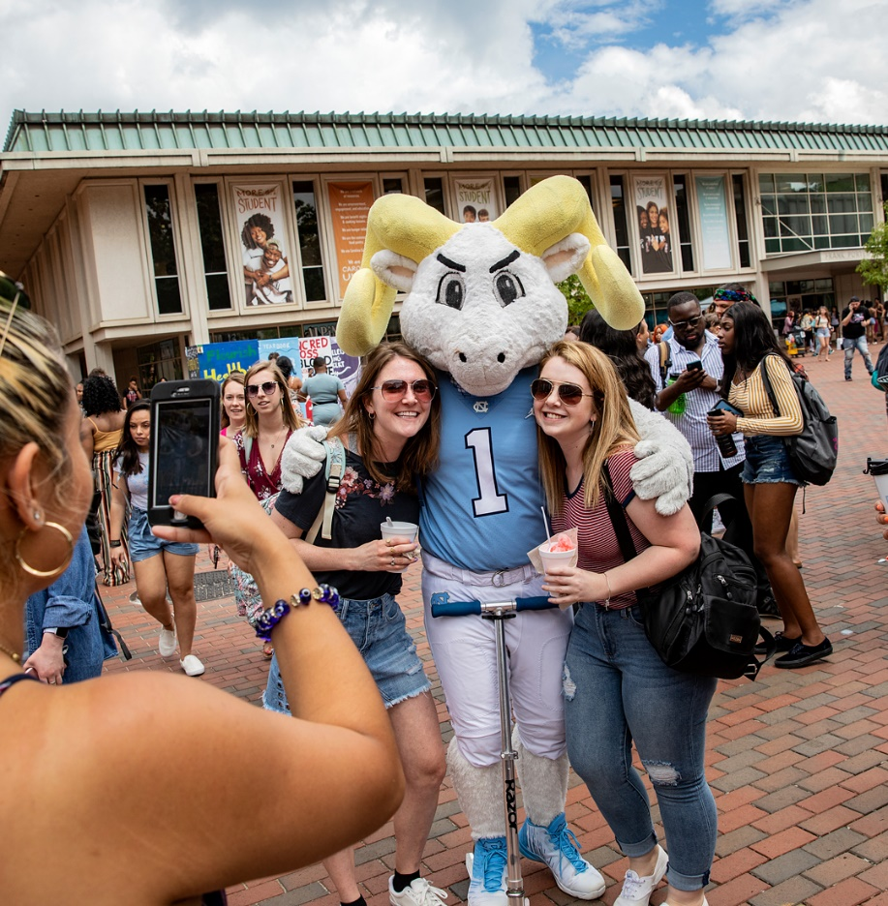
Documentation
Hired WS students must complete all required payroll forms with the
hiring department’s HR Representative/Shared Services Center &
submit their employment verification form to their supervisor before
they can begin working
Hired WS students are housed under the hiring department’s number
for payroll purposes but the WS account is used as the funding source
Required payroll forms include NC-4, W-4, Direct Payroll Deposit
Authorization, and Electronic I-9 Employment Eligibility Verification
All WS employees must use Kronos Time Information Management
(TIM) System and complete the training here before their first workday
WS students & supervisors are required to approve work hours on
a biweekly basis before the department TIM Administrator performs the final sign-off, pay periods and dates can be found on the SHRA Biweekly Schedule
Notes:
WS Student TIM Training: https://apps.fo.unc.edu/finance/training/tim-students-temps/
Time information for pay periods as well as expected submission days and pay dates can be found here: https://finance.unc.edu/services/payroll-preparation-and-distribution/

Slide 14
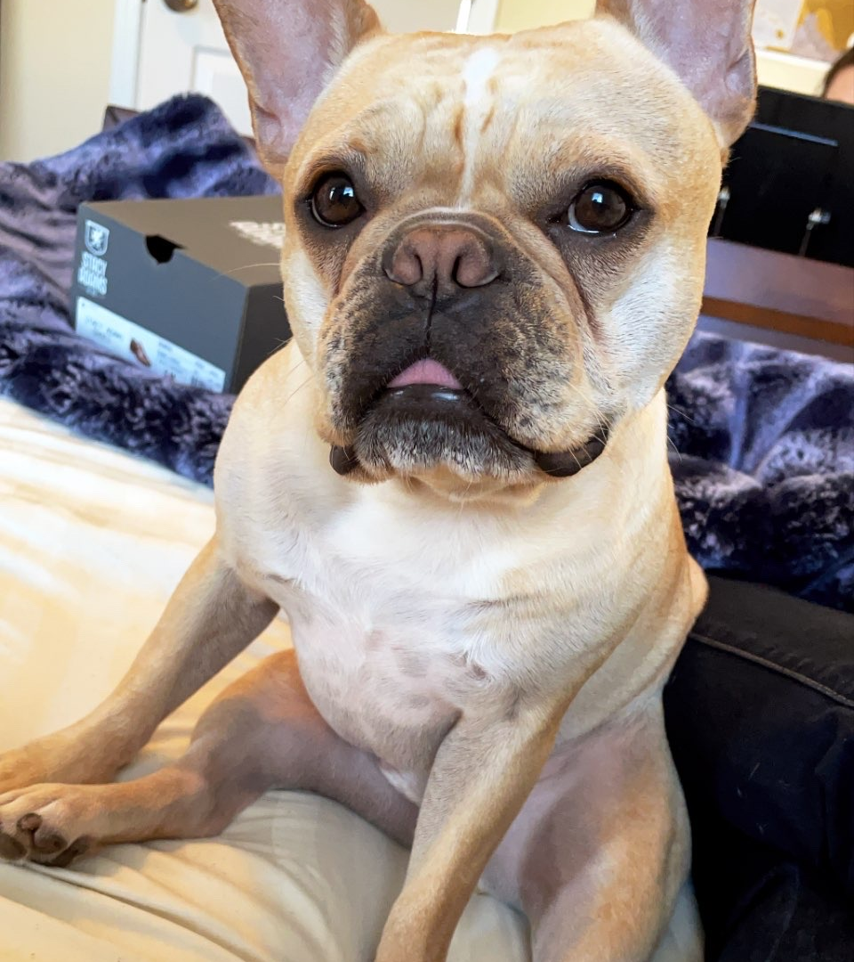
Halfway Point,
Get a snack, take a walk.
Look at this cute picture of our work-study mascot Huey
Notes:
Huey is available for pets and walks by visiting Assistant Director Meg DeMarco’s office on select days a week. Email work-study to secure your exclusive visit- only available to WS supervisors and WS students

Slide 15
Student Responsibilities
Complete WS training and provide all requested documentation to HR prior to beginning work
Establishing a work schedule with supervisor
Reporting to work on time and complete tasks on time/as assigned
Notifying the supervisor of any absence or derivation from the established schedule due to illness, emergencies, or valid academic conflicts (e.g. office hours, advising appointments)
Refraining from prohibited activities: studying on the job, misreporting hours worked, working over limits, failing to perform job duties, etc.
Refraining from discouraged activities: personal calls, texts, e-mails, & social media updates
Notifying the supervisor of any changes to their WS award
Notes:
Working with a supervisor on mutually acceptable schedule revisions, if needed
Both the Student and supervisor should:
Maintaining accurate records of all hours worked
Communicating regarding the failure of either party to meet established responsibilities and working to find a solution if such failures occur
Ensuring the position helps the student progress towards their academic, professional, and/or personal development goals
Preventing the student from exceeding weekly/annual work limits

Slide 16
Supervisor Responsibilities (1/2)
Not discriminating based on race, color, gender, national origin, age, religion, creed, disability, veteran status, sexual orientation, gender identity, gender expression, and other protected areas
Verifying that any new WS job does not replace an existing position
Ensuring the student is properly hired through JobX and processed with departmental HR
Collecting & retaining certification that the student-employee completed mandatory WS training and any department-specific training
Ensuring that WS students do not engage in work before the hiring/payroll process is complete with HR
Notes:
Both the Student and supervisor should:
Maintaining accurate records of all hours worked
Communicating regarding the failure of either party to meet established responsibilities and working to find a solution if such failures occur
Ensuring the position helps the student progress towards their academic, professional, and/or personal development goals
Preventing the student from exceeding weekly/annual work limits

Slide 17
Supervisor Responsibilities (2/2)
Keeping accurate records of all hours worked by the WS student and ensuring overages do not occur
Ensuring a primary and/or secondary supervisor is available to students for sign-in, sign-out, supervision, instruction and emergency assistance any time a student is working
Providing sufficient training to empower students to accomplish the requirements of the position
Presenting and clarifying job expectations and departmental requirements
Treating the student as a professional staff member and encouraging open and honest communication with the WS student
Providing ample work to ensure students are busy and not engaging in prohibited activities (e.g. studying) during their shift
Providing regular feedback regarding job performance and formal evaluations at least once per semester
Ensuring that the WS student remains in compliance with federal, state, institutional, and program regulations

Slide 18
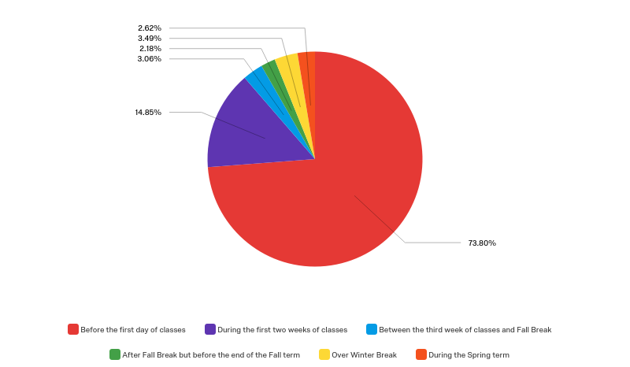
When should I post my positions?
When will students start to apply?
EARLY JULY
Notes:
74% begin looking for a job before school ever starts;
90% do their looking before the third week of classes.
Make sure to post your jobs as soon as the program calendar allows in early July to reach these students
A 2019 survey of over 600 WS student-respondents revealed the top 3 complaints of WS student participants are the same as in previous years:
Students did not have enough work to do
Students wanted more responsibility and more difficult projects
Students did not plan their hours properly and either didn’t earn their full award or ran out of funding too early in the year
To help prevent these issues, we strongly recommend
Keeping a list of additional tasks on hand that students can complete as time allows (e.g. research, benchmarking, developing training guides). Planning out larger, semester- or year-long projects that students can be in charge of and work on as time allows.
Helping students plan out their hours for the year when they first come on staff (e.g. calculate number of hours/week they’ll need to work during each week of the academic year in order to earn their full award)
Creating & instituting a training program at the beginning of the year. Include ways for students to continue advancing their skills as time allows over the remainder of the year so that they can move on to higher levels of responsibility.

Slide 19
Hiring and Wages
We strongly recommend that you set up the appointment between the student and your HR Representative/Shared Services Center and do so prior to the anticipated first day of work
Once your HR Representative/Shared Services Center has approved the student, the student is cleared for employment with the University, Students may begin work on the first day listed in our program calendar if all steps are complete. Please do not let your students begin work before this time!
Students will receive biweekly paychecks for hours worked approximately 12 days after the end of the pay period, around 14 days after the end of the pay period, wage disbursement information is sent to the WS team
At this time, the WS team will begin reconciling student earnings. The WS team will contact students and their supervisors if one of the following conditions is true:
A student’s total earnings is within $550 of their FWS award
A student’s total earnings have exceeded their FWS award
If the student’s earnings exceed their award, supervisors will be required to submit a PAAT entry for the overage and either convert the student to departmental funding or end their employment.

Slide 20
During the 2019-20 academic year, supervisors only requested to release 8 students for performance issues, but many more students were terminated due to studying abroad, changing positions, graduating early, or student-requested termination
Students who fail to meet job duties can be removed from their positions at the Supervisor’s discretion if the following conditions are met:
Documentation of the student’s performance issue(s) and attempts to correct the issue(s) must occurs before students are terminated. This should involve meeting with the student to discuss expectations of the position and how the student is not meeting them as well as a performance improvement plan
You must consult with your departmental HR to ensure you have followed all required protocols for termination and the student must be notified in writing/email of their termination prior to any action being taken
Supervisors terminating an employee should complete the termination request form found here and review the training regarding termination procedures under supervisor resources. Students are at-will employees.
Student Termination
Notes:
While uncommon, WS employees can be removed from, leave, or change positions during the academic year
Most disciplinary issues result from three factors
Lack of supervision & guidance (especially regarding expectations)
Attendance issues
Unclear communication
To combat these issues, we recommend the following solutions:
Clearly document and discuss each student’s assigned duties and expectations with them at the beginning of the year. If those items vary over time, make sure to document the changes & review the information with the student.
Create a mutually agreed upon work schedule and operating policy/procedure for each student worker. Have a procedure in place to amend the schedule, should the need arise.
Have designated staff on hand to help supervise and work with WS employees at all times, including when the primary supervisor is not available (e.g. ill, in meetings).
Schedule regular meetings/communication with each WS student; just 5 minutes once a week can prevent major issues.
Complete required semesterly evaluations to provide students with performance feedback

Slide 21
Because the WS program is contingent on external funding federal and internal, we are required to meet established guidelines in order to maintain eligibility. Failure to meet requirements by one supervisor can negatively impact program eligibility & funding for all participants. As such, OSSA reserves the right to take any and all actions necessary to ensure the continuation of the WS program
Any supervisor that allows a student to earn more than their allotted award will be evaluated for suitability to continue participation in the WS program
Departments/supervisors with repeat violations may not be eligible to participate in the WS program in future aid years
Any department that fails to meet their responsibility in paying for excess or unauthorized wages will be removed from the WS program
Supervisor Termination
Notes:
The following are the four most common program administration errors by supervisors during the 2019-20 academic year
Allowing the student to exceed their annual earnings limit
Allowing the student to begin work without collecting proof of their WS Training completion
Allowing the student to begin work without completing the required verification and payroll process with their HR Representative
Hiring students without their approval
We strongly recommend tracking student hours AND making a hiring checklist

Slide 22
Before your Jobx Training…
Review the Program Calendar and add Key Dates to you Calendar
Download the Work Schedule Planner to track/monitor student hours, balances, and academic breaks
Review the UNC hiring checklist and additional resources here
Notes:
New Here? New Supervisor in general? Check out the extra resources on our website
https://studentaid.unc.edu/work-study-program/work-study-supervisor-resources/

Slide 23
FIRST TRAINING DONE!
COMPLETE THE SECOND AND LAST TRAINING ON JOBX NEXT

