Slide 1
Work-Study
Student
Jobx Training
21-22
Notes:
This presentation is for ALL work-study students, Carolina works and Federal Work Study!

Slide 2
Additional information for each slide will be in the slide notes if you need a more detailed explanation

Slide 3
Review regulatory training
Review the program calendar and student resources
Review Student Jobx Training (Here! You made it!)
Pass your annual* quiz
Gain access to Jobx and apply for positions
Upon hiring, complete the onboarding process
Annual Student Requirements New and Returning*
Notes:
You should have reviewed the regulatory presentation first! If you have not yet, complete steps 1 and 2 before this training
Make sure you have reviewed the OSSA Work-Study website and explore the work tools and student resources. You will want to add the key dates from the program calendar on your planner or outlook calendar: https://studentaid.unc.edu/work-study-program/work-study-student-resources/
Here! You made it! Now you will complete the Jobx system training to learn how to apply for positions, track application statuses, and set up job mail alerts
The quiz will be on the OSSA website and should only be completed once the above 3 steps are finished. You may take the quiz an unlimited number of times but must receive a score of 100% before applying to positions in Jobx. You will need to retain a copy of your quiz score to show your supervisor upon being hired.
Once you have completed your quiz, access Jobx and begin hiring for positions. The Jobx training will walk you through this!
The onboarding process will be explained at the end of this presentation and an onboarding quick guide exists under student resources

Slide 4
Training Sections and Quick Links
Accessing Jobx
Searching for Open Positions
Applying for Open Positions
Setting up JobMail notifications
Interviewing and accepting an offer of employment
On-boarding process
Notes:
Jobx is the current system of record for all Work-Study (WS) placements.
JobX currently serves 6 main functions:
Provides an online space for employers to create and post positions
Provides an online system by which students can search job postings
Functions as an application/selection portal allowing students to apply to positions and managers to hire them
Serves as a hiring record system, keeping track of which student is employed in which position
Retains communication and reporting information, allowing the FWS office to contact students and supervisors with current positions
Hosts an informational website for resource dissemination

Slide 5
a) Accessing Jobx
b) Searching for Open Positions
Jobx Link
Notes:
Enter the Jobx website.
https://unc.studentemployment.ngwebsolutions.com/Cmx_Content.aspx?cpId=6
Select “Students” on the first picture to the left.
JobX currently serves 6 main functions:
Provides an online space for employers to create and post positions
Provides an online system by which students can search job postings
Functions as an application/selection portal allowing students to apply to positions and managers to hire them
Serves as a hiring record system, keeping track of which student is employed in which position
Retains communication and reporting information, allowing the FWS office to contact students and supervisors with current positions
Hosts an informational website for resource dissemination

Slide 6
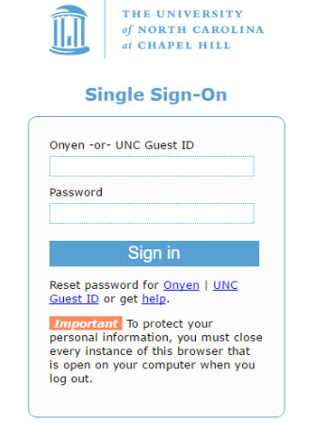
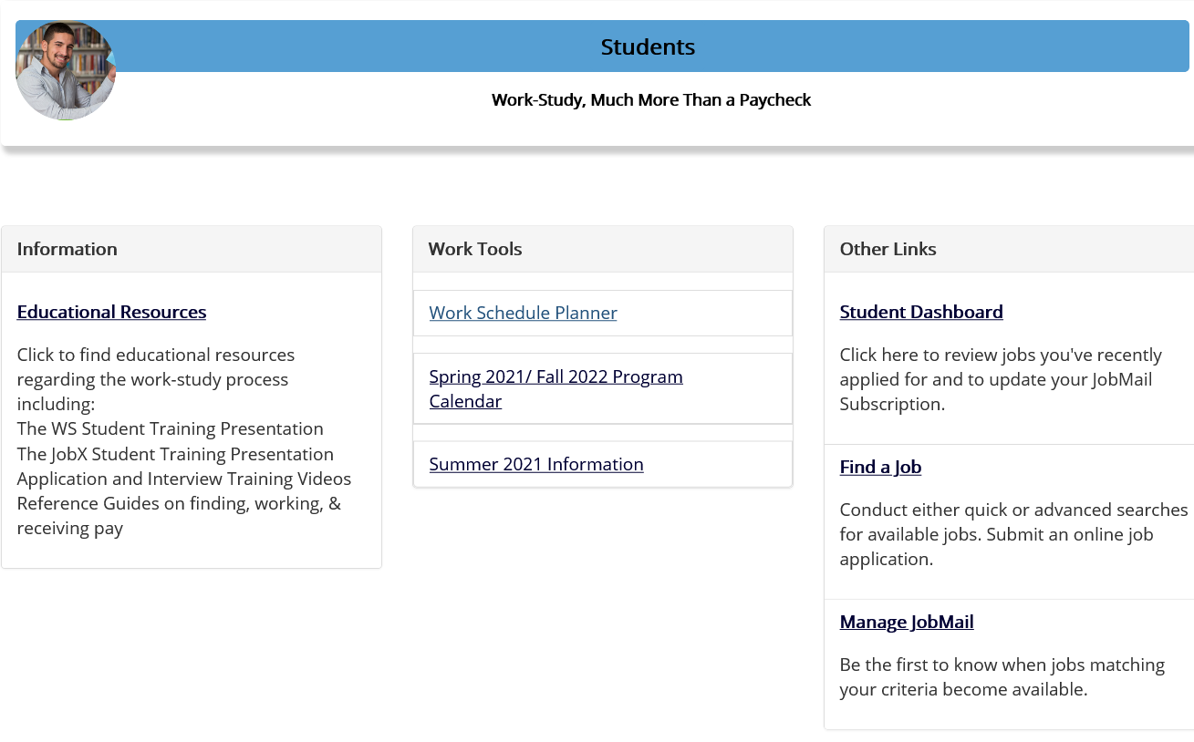
Accessing Jobx
The program calendar will state when Jobx will be open for students. You will also be notified
by email that the system is active, once you receive the email you may begin searching for jobs
Follow the Student Link in the top right square. Select the “Students” page on the left when the website opens
Student Link
Only students who have a work-study award have access to Jobx Positions. Log in using your onion to verify your eligibility
Search for open positions using the “Find a Job” Link

Slide 7
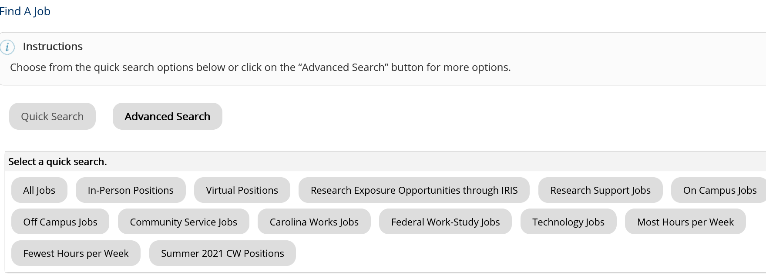
b) Searching for Open Positions
After selecting the “Find a Job” Tab, you will have two options.
You can select a category from the “Quick Search” buttons such as viewing all jobs, all Carolina Works, or all federal-work study.
You can also go to the Advanced search area and search by keywords. Just make sure to choose the correct Job Type!
If you select the advanced search option, Select the correct Job Type and then search using your keyword

Slide 8
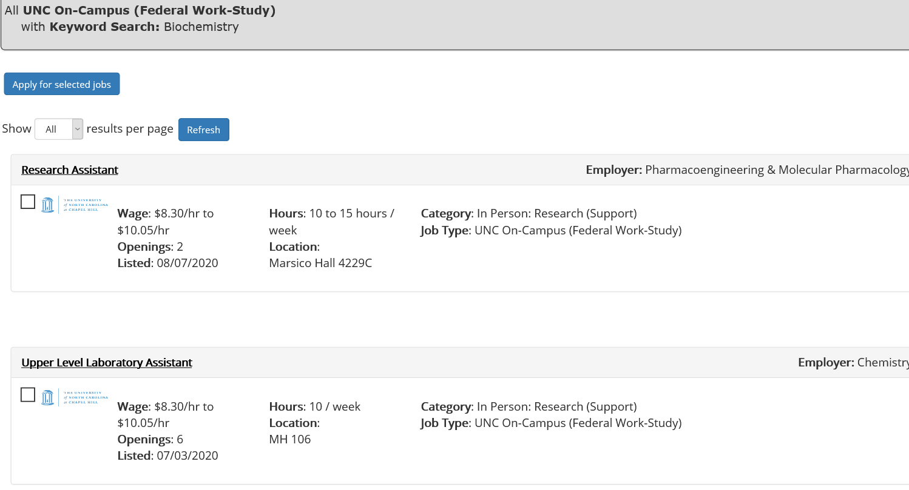
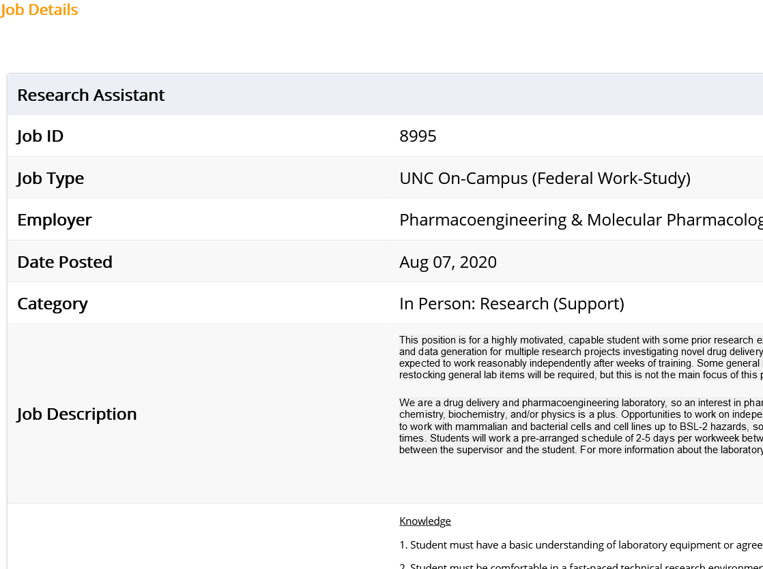
b) Searching for Open Positions
Once you search, on the job list page look for jobs you are interested in. Click the “Job Title” to view more information about the position in a separate tab.
Once you open the position details, review and see if the job duties, number of hours, skills and more match your interests. Once you have reviewed, navigate back to the “Find a Job” Page

Slide 9
b) Searching for Open Positions
On the Job List page, you can select 1-3 jobs for which you would like to apply. Check them on the left side, then press the “Apply for Selected Jobs” link.
If you found more than 3 jobs, you can repeat the process to apply for those jobs later. While the system limits you to 3 jobs per application, there is no restriction on the maximum number of jobs to which you can apply each year.

Slide 10
c) Applying for Open Positions
Jobx Link

Slide 11
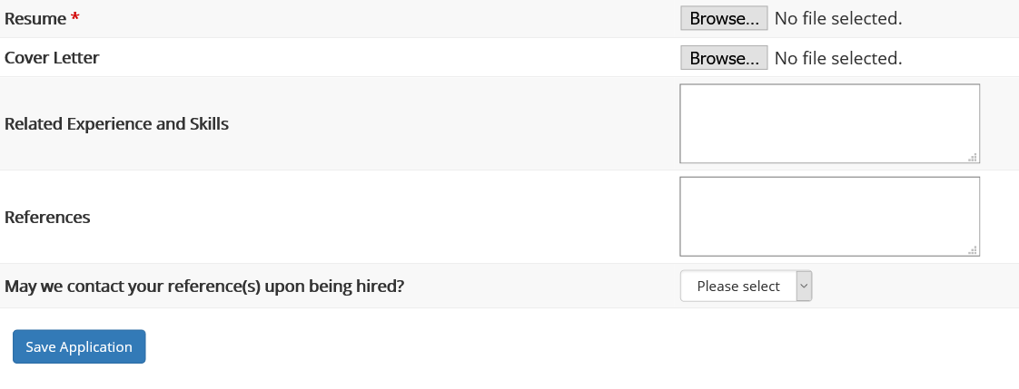
c) Applying for Open Positions
To apply, fill out the application making sure that you complete all fields with a red asterisk. Fields without a red asterisk are not required, but we highly recommend completing them as leaving the field blank may put you at a disadvantage.
To upload a resume and/or cover letter for the hiring supervisor to review, browse to that file on your computer and click ‘Open’. Remember, help is available through the University Career Center if you need assistance with your job application documents
Once you’ve completed the application, be sure to click the “Submit” button at the bottom of the page to officially apply for the selected job(s). JobX will not save your data if you leave the page, so please be sure to complete the process before signing off.

Slide 12
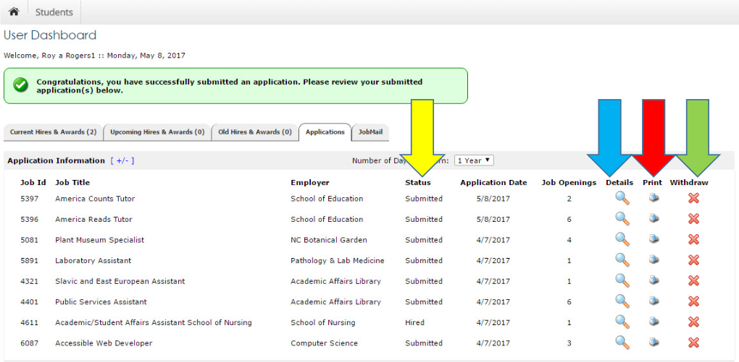
c) Applying for Open Positions
Once you successfully submit the job application, you will be sent to your user dashboard.
From here you can complete a variety of actions such as:
-Viewing the application status
-Printing an application by
clicking the printer icon next
to the job listing
-Reviewing your submitted
information by clicking on
the magnifying glass icon
-Withdraw your application
by clicking on the red X
button
Once you accept a position, Withdraw from all other applications
Notes:
Once you are finished reviewing your current application materials, you can
- Return to the job search page to apply for additional jobs
- Log out of the system
- Review your JobMail account

Slide 13
d) Setting up JobMail notifications
Jobx Link

Slide 14
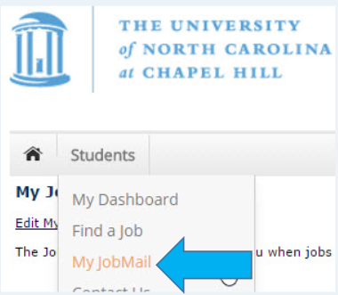
d) Setting up JobMail notifications
JobMailis a system that notifies you automatically by e-mail when jobs of interest to you are posted. To enable JobMail, you must complete a JobMail subscription defining what types of jobs interest you. Once you’ve updated your subscription, if any attribute of a new job being listed matches your subscription attributes, you will receive e-mail from the system.
Know that when you set your subscription attributes, there may still be jobs on the site that match your interest but are not included in your e-mail notifications if supervisors do not opt into JobMail.
Instructions:
In the Student Dashboard:
-Mouse over the “Students” tab at the top of the page
-Navigate to the My JobMail option
-Click the link to navigate to the JobMail page
Notes:
This e-mail will provide all the necessary details about the job so you can proactively apply for the job, if interested. Although most supervisors opt to have their listing included in the JobMail feature, not all supervisors elect to do so.

Slide 15
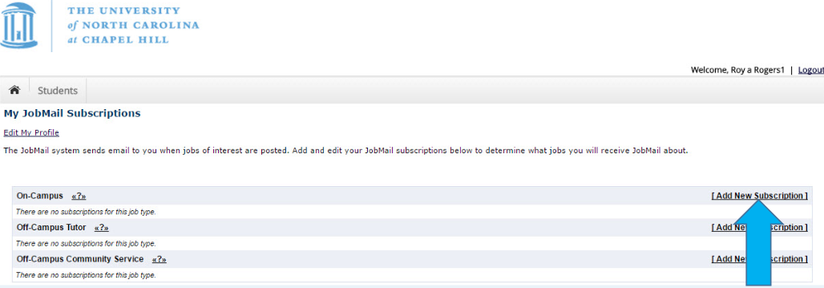
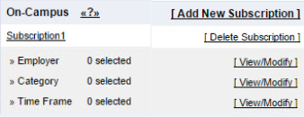
d) Setting up JobMail notifications
In the JobMail Dashboard, click the
link to “Add New Subscription” link
to add a subscription. Please note that
you do not have to apply to a certain
job or job type in order to subscribe
to the JobMail messaging regarding
similar positions
Once you’ve subscribed, you’ll receive new options to
delete the subscription, or to refine the subscription by selecting
specific employer(s), category(s), and/or time frame(s) of interest.
You will only be messaged if change occur to positions corresponding FWS positions
Notes:
Clicking the “View/Modify” link will open up a new menu of options

Slide 16
e) Interviewing and accepting an offer of employment
Jobx Link

Slide 17
e) Interviewing and accepting an offer of employment
Interviews are conducted by supervisors based on the JobX application to ensure the position is a good fit for everyone involved.
They can be conducted via phone, over the web, or in person.
Most students participate in 1-4 interviews before finding the right position.
*Continuing students returning to the same position can bypass the interview, if their supervisor chooses to do so*
Once you receive an offer, you’ll want to respond quickly. Most
supervisors prefer that you provide them an official acceptance
notice in writing, but some may be fine with a phone call. Be sure
to ask!•Once you have accepted, an offer of employment, please ask
your supervisor to set up an appointment for you to meet with the
hiring department’s HR representative on or before your first date of
work
After accepting an offer, you should withdraw all other job applications!

Slide 18
e) Interviewing and accepting an offer of employment
Payroll!
Before you can begin work, you will have to complete a set of tasks to received authorization for employment from HR
Employment verification through the I-9 system
Provide documentation to confirm your eligibility to work before starting your new job
To complete this process, you may need your passport, social security card, driver’s license, or other forms of identification.
Depending on individual circumstances, you may need to consider bringing some of these documents from home or, for virtual employees, going to a remote I-9 center to complete the process as indicated by the department
Withholding set-up using the W-4 & NC-4
You’ll need to complete these forms to ensure the proper number of wages are withheld to pay taxes
Payroll set-up using the Direct Deposit Authorization Form
If working on campus, you’ll need to provide your banking information in order to receive your wages. Having a paper check can help expedite this process

Slide 19
e) Interviewing and accepting an offer of employment
Payroll Set Up-ON CAMPUS!
All WS students MUST be set up in payroll, submit a copy of their WS Training with a 100% grade, and complete I-9 verification on or before their first day of work. Failure to do so will violate WS program regulations and may violate US employment law.
If you do not have a meeting with HR on or before your first day of work, please ask your supervisors to set one up, otherwise you may not be paid on time. If you have any questions about how to complete these processes, please ask your WS supervisor for assistance.
Find the Kronos Tim training here!
Payroll Set Up-OFF CAMPUS!
All WS students MUST submit their WS Training quiz with a 100% score and complete I-9 verification on or before their first day of work. Failure to do so will violate WS program regulations and may violate US employment law. You may have additional processes specific to your worksite that you will need to complete prior to beginning work. If you have any questions about how to complete these processes, please ask your WS supervisor for assistance.
Notes:
On campus positions require students to take the TIM training here https://apps.fo.unc.edu/finance/training/tim-students-temps/

Slide 20
f) On-Boarding Process
Jobx Link

Slide 21
f) On-Boarding Process
Before you begin work, you’ll need to provide your supervisor with documentation that you successfully completed Work Study Student Training by screenshotting your completion page after you take the quiz on the Work-Study Student website. You must score 100% before applying to jobs.
You may begin work only if all set-up steps are complete and classes have begun. Please do not begin work before the first day of work listed on the Program Calendar!
Please do not begin work until all Payroll & WS Training has been completed!

Slide 22
f) On-Boarding Process
Your supervisor will also complete the following tasks:
•Have you complete the Chronos/TIM/timesheet
training
•Show you how to fill out the sign-in/sign-out sheet
•Give you a tour of the work area
•Introduce you to coworkers and secondary supervisors
•Explain your job responsibilities and expectations in more detail
Your supervisor may provide additional on-boarding like:
•Reviewing workplace protocols and office norms
•Setting up evaluation periods
•Discussing additional training opportunities
•Asking you to complete job-specific privacy training

Slide 23
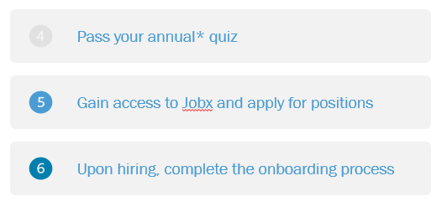
Thank you for Completing the Student JobX Training! Next Steps:
Notes:
Huey, AKA Hubert A. DeMarco, the first of his name. Can be found in Pettigrew hall for pets and walks. An exclusive offer for WS students and supervisors.

